Slide 1

A PRESENTATION ON “PULWAMA ATTACK”

Slide 2
Presentation Outline
INTRODUCTION
FEATURES OF OPENGL
BASIC OPENGL OPERATION
SYSTEM REQUIREMENTS
HARDWARE AND SOFTWARE REQUIREMENTS
IMPLEMENTATION
CONCLUSION

Slide 3
INTRODUCTION
OpenGL is the abbreviation for open Graphics Library.It is the software interface for graphics hardware.
This interface consists of several hundred functions that allow you, a graphics programmer, to specify the objects and operations needed to produce high-quality color images of two-dimensional and three-dimensional objects.
The main purpose of OpenGL is to render two-dimensional and three-dimensional objects into the frame buffer.
The aim of the project entitled is to illustrate the concepts and usage of “PULWAMA ATTACK” using OpenGL technology and Visual Studio C++ as the platform for compilation.

Slide 4
FEATURES OF OPENGL
Industry standard
Stable
Reliable and portable
Evolving
Scalable
Easy to use
Well-documented

Slide 5
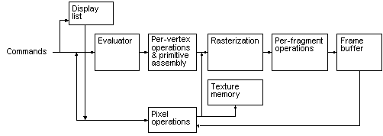
BASIC OPENGL OPERATION
The following diagram illustrates how OpenGL processes data.
Fig: OpenGL Block Diagram

Slide 6
THE OPENGL INTERFACE
GL – Graphics Library
Functions in the main GL (or OpenGL in Windows) library have names that begin with the letters gl and are stored in a library usually referred to as GL (or OpenGL in Windows).
GLU – Graphics Utility Library
This library uses only GL functions but contain code for creating common objects and simplifying viewing. All functions in GLU can be created from the core GL library but application programmers prefer not to write the code repeatedly.
GLUT – OpenGL Utility Toolkit
To interface with the window system and to get input from external devices into our programs we need at least one more library. For the X window System, this library is called GLX, for Windows, it is wgl, and for the Macintosh, it is agl. Rather than using a different library for each system, we use a readily available library called the OpenGL Utility Toolkit (GLUT) .

Slide 7
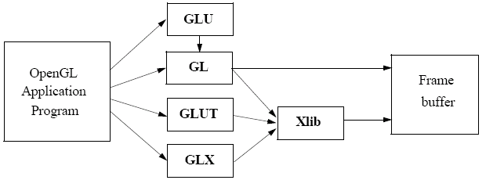
Fig: Library Organization

Slide 8
SYSTEM REQUIREMENTS
Software Requirements
operating System : Microsoft Windows XP,Microsoft Windows 7
2. Compiler used: VC++ 6.0 compiler
3. Language used: Visual C++
Hardware Requirements
1. Main Processor: PENTIUM III
2. Processor Speed: 800 MHz
3. RAM Size: 128MB DDR

Slide 9
IMPLEMENTATION
OVERVIEW
This project is demonstration of “PULWAMA ATTACK” .We have taken the help of built () in functions present in the header file. To provide functionality to our project we have sub functions. These functions provide us the efficient way to design the project. In this chapter we are describing functionality of our project using these functions.

Slide 10
CONCLUSION
Pulwama attack lead to the death of 40 CRF jawans, which is indeed great loss to the nation .may their rest in peace. Jai Hind

Slide 11
THANK YOU

